Slide 1

GDP’s Role in Olympic Glory
Presented by:
Ashish
Arash Ahmadi
Pravin Senkottaiyan Baskaran

Slide 2
Overview
Data Source
1
Olympic medal and World Bank GDP data.
2
Summary Statistics
Descriptive statistics calculated; data cleaned and transformed.
Methodology and Analytical Framework
3
Regression analysis examined GDP vs. medal count.
4
Results
Initial findings suggest a correlation, requiring further testing.

Slide 3
Datasource
Olympics in France
The 2024 Summer Olympic Games will be held in Paris, France. This will be the third time France has hosted the Olympics, having previously hosted in 1900 and 1924.
World Bank GDP Data
The World Bank provides comprehensive data on Gross Domestic Product (GDP) for countries around the world. This includes the latest 2023 GDP figures that will be used in the analysis.
2023 Population Data
Population data for 2023 will also be included to explore the relationship between a country's population size and Olympic medal performance.

Slide 4
Summary Statistics
Field
Value
N
90
Total Medals
Mean: 11.53, SD: 19.78
GDP per Capita
Mean: $24,478.05, SD: $25,547.86
GDP
Mean: $1,085,174.15 million, SD: $3,463,628.05 million
Population
Mean: 69.03 million, SD: 213.29 million
Region
Africa
12 countries (13%)
Asia
26 countries (29%)
Caribbean
4 countries (4.4%)
Europe
31 countries (34%)
North America
7 countries (7.8%)
Oceania
3 countries (3.3%)
South America
7 countries (7.8%)
*
Mean (SD); n, (%)

Slide 5

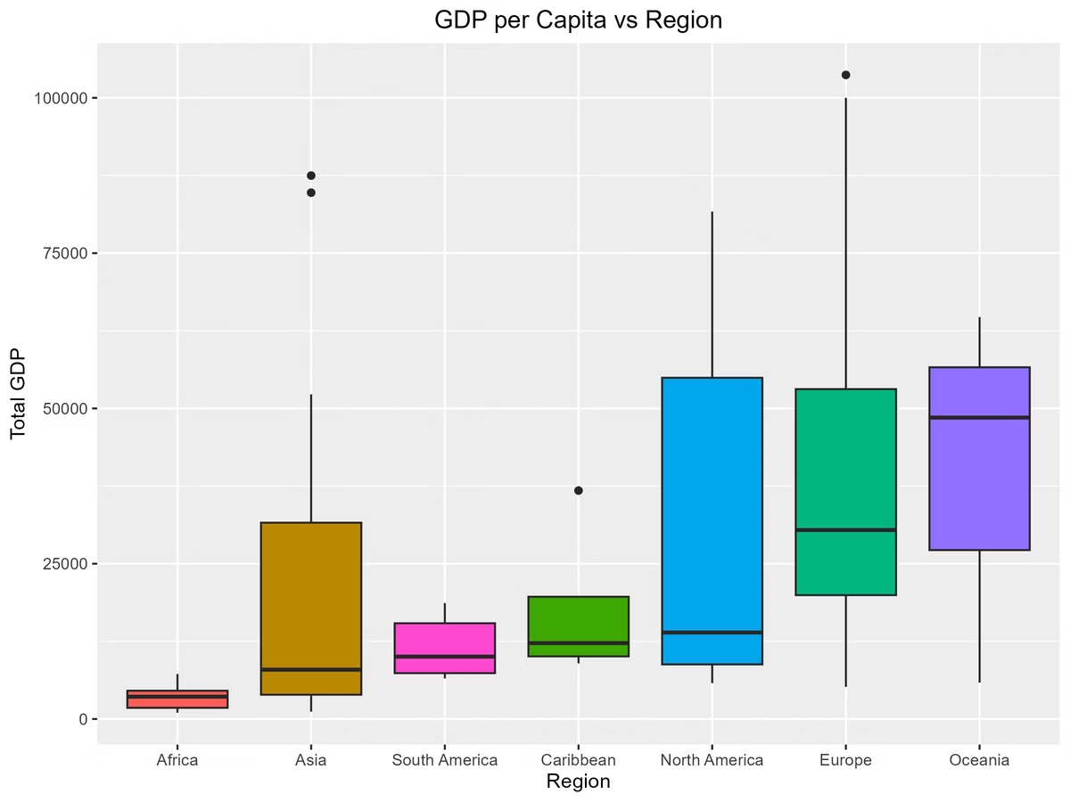
GDP per Capita vs Region
Global GDP per capita varies significantly by region, reflecting economic development.
North America & Europe: Highest GDP per capita, but with internal variation.
Asia & South America: Diverse GDP, with strong and struggling economies.
Caribbean, Oceania, parts of South America: Intermediate GDP, a mix of developing economies.

Slide 6

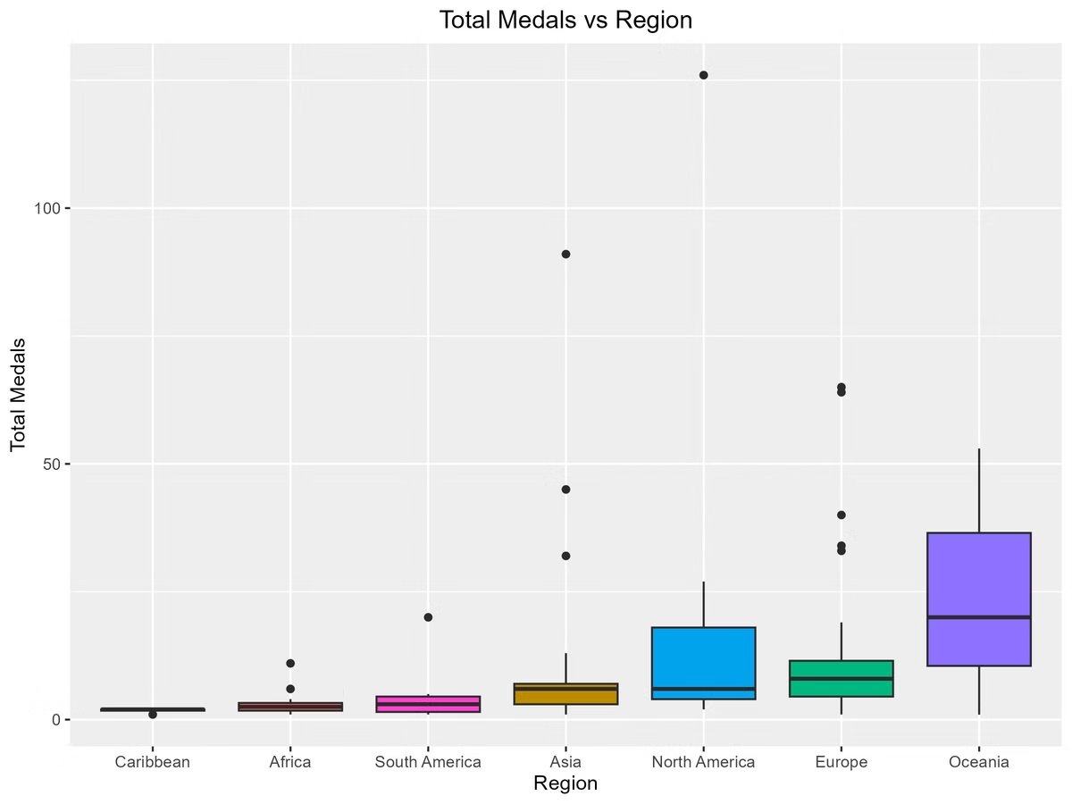
Total Medals by Region
North America & Europe: Significantly higher medal counts than average.
Asia: Moderate medal count, suggesting strong but less dominant performance.
Caribbean, Africa, South America, & Oceania: Noticeably lower medal counts; further investigation needed.
Further Analysis: Country-level breakdown, considering population and GDP, is recommended.

Slide 7

Methodology and Analytical Framework
Explore relationships
Validate Assumptions
Model (I) summary
Transform GDP data
Validate Assumptions
Model (II) Summary

Slide 8
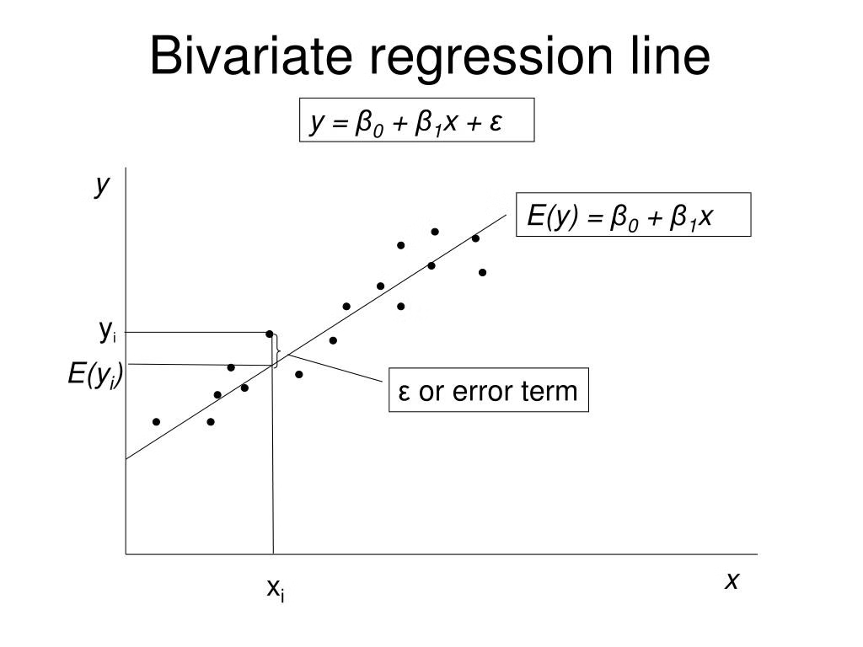
Explore Relationships
National wealth impact on Olympic performance
H₀: β1 = 0 (no linear relationship)
H_{A}: β1 ≠ 0 (There is linear relationship)
Total Medals = β0 + β1(GDP) +ε

Slide 9
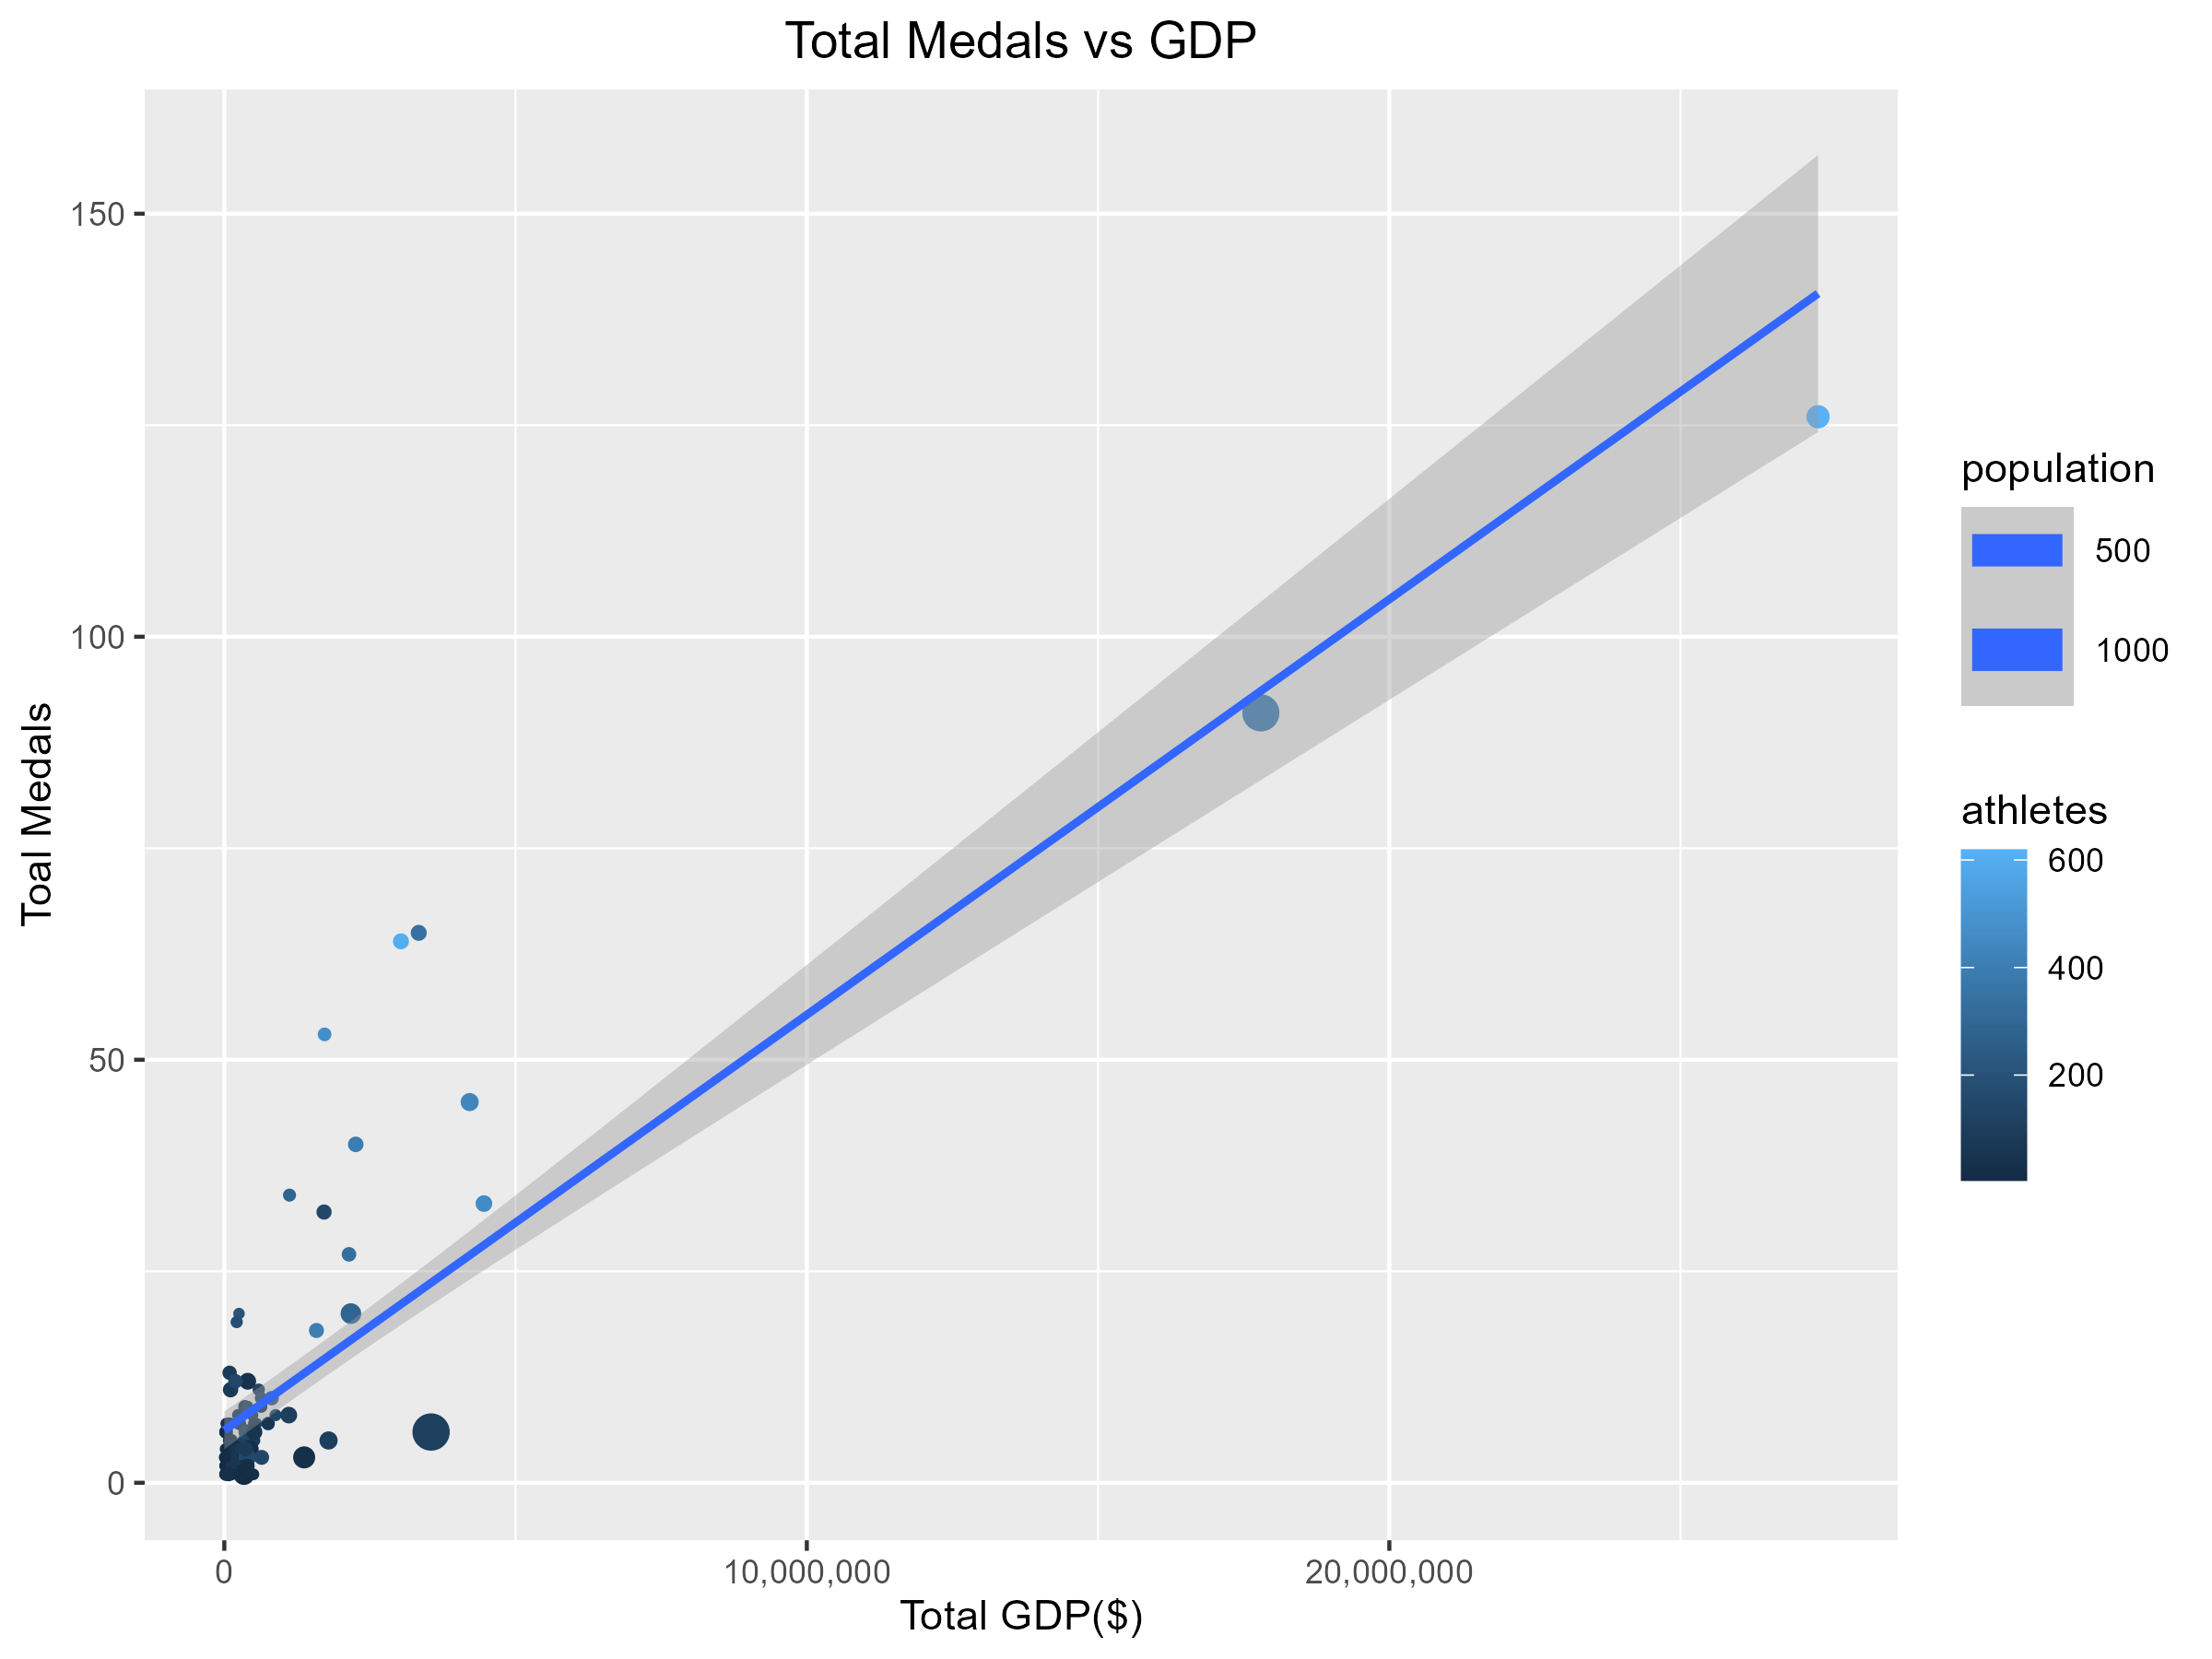



Total Medals vs
Total GDP
Positive Correlation
Higher GDP generally linked
to more medals
Population Factor
Color coding reveals
population size impact
Outliers Present
Some countries deviate
from the trend(US, China)

Slide 10
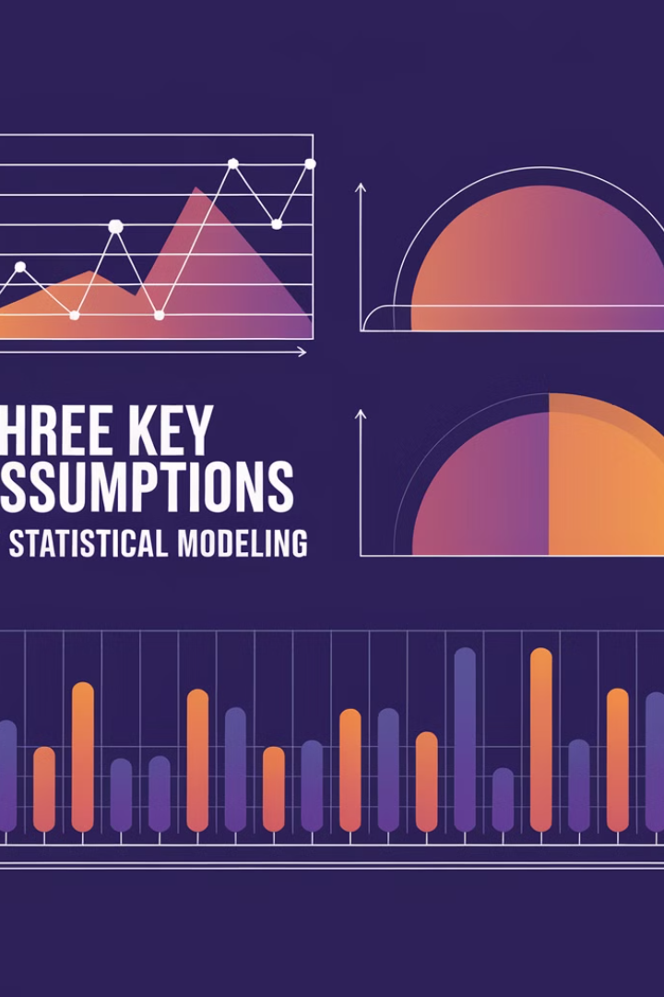
Assumptions
Linearity
Independence
Normality
Constant variance

Slide 11
Linearity

Slide 12
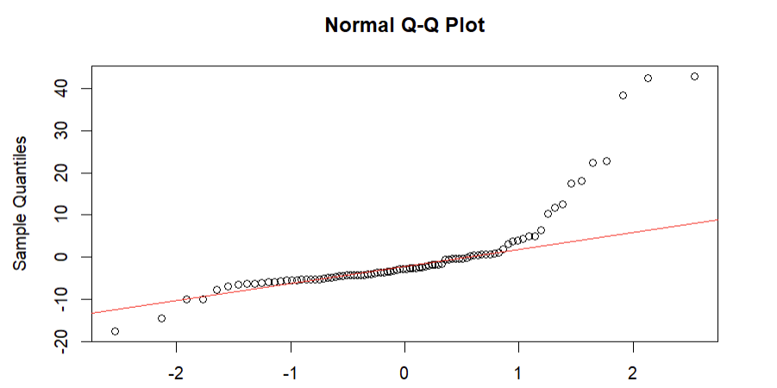
Normality

Slide 13
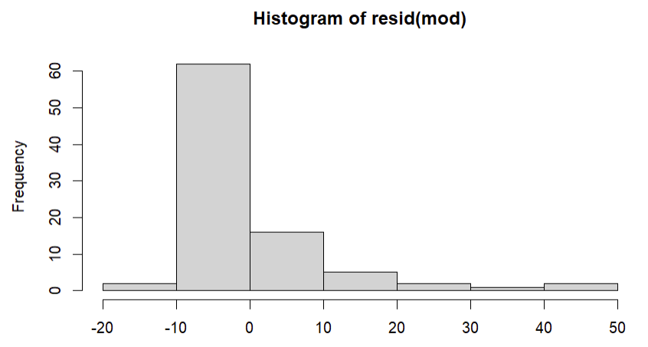
Normality

Slide 14
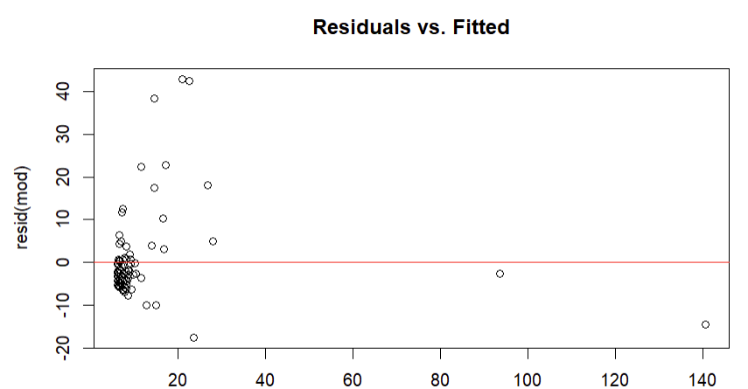
Equal (Constant) Variance

Slide 15



Assumption Testing
Q-Q Plot
1
Deviations from normal distribution visible
Histogram
2
Right-skewed residual distribution
Conclusion
3
Normality assumption not fully met

Slide 16

Model (I) Summary
Total Medals = 6.204 +4.911e-06(GDP)
CI = (4.293133e-06 , 5.528619e-06)
R-squared
0.7364
P-value
2.2e-16

Slide 17
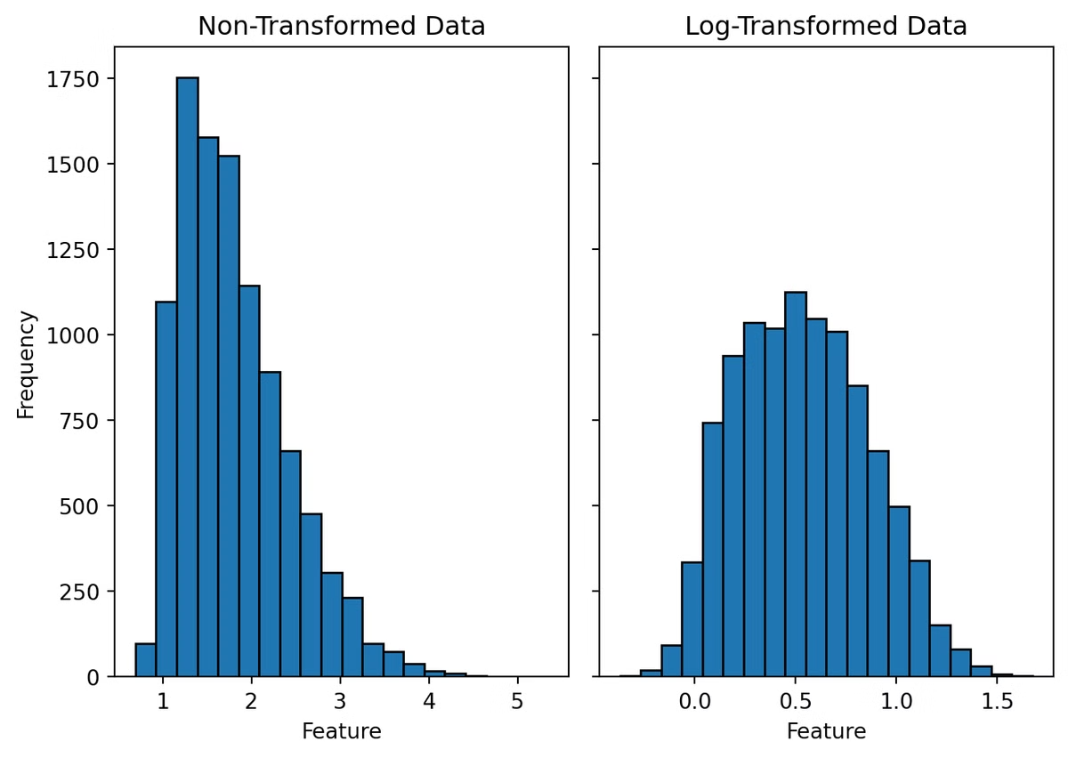
Data Transformation
1
Issue
Assumptions not met for total GDP
2
Solution
Applied log transformation to total GDP
3
Result
Improved normality and linearity

Slide 18
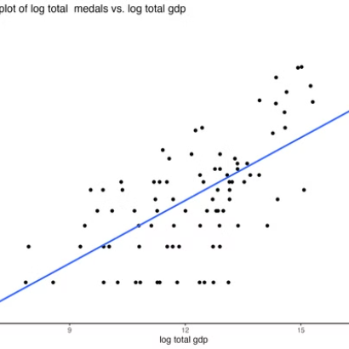
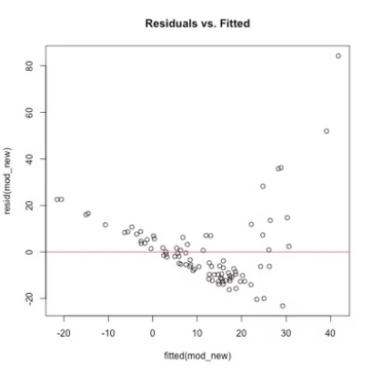
Assumption Testing

Slide 19
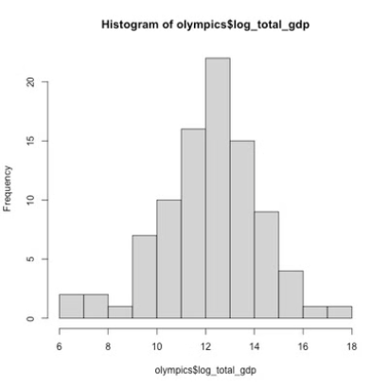
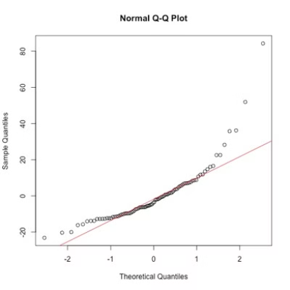
Assumption Testing

Slide 20

Transformed Model Results
0.3661
1.608e-10
R-squared
p-value
CI = (4.443446 , 7.805999)
Total Medals = -63.142 +6.125(GDP)

Slide 21
Hypothesis Test Results
The extremely low p-value (1.608e-10) strongly rejects the null hypothesis, providing highly significant evidence of a relationship between log transformation of total GDP and the number of Olympic medals won. This confirms that there is a statistically significant relationship between a nation's GDP and its Olympic medal count.

Slide 22
Conclusion and Next Steps
GDP's Strong Influence
1
Our analysis reveals a statistically significant relationship between a nation's GDP and its Olympic medal count.
Model Refinement
2
Employing a log transformation on GDP significantly improved the model's adherence to key statistical assumptions, enhancing the reliability of our results.
Future Directions
Further research should explore additional factors beyond GDP, such as population size, investment in sports infrastructure, and national sports policies, to build a more comprehensive understanding of Olympic success.
3

Slide 23
References:
chrome-extension://efaidnbmnnnibpcajpcglclefindmkaj/https://repository.gatech.edu/server/api/core/bitstreams/1aa2b537-c3de-4177-8295-3fcd3a03a965/content
chrome-extension://efaidnbmnnnibpcajpcglclefindmkaj/https://faculty.tuck.dartmouth.edu/images/uploads/faculty/andrew-bernard/olymp60restat_finaljournalversion.pdf

Slide 24
Any Questions:
Please feel free to ask.

